Slide 1


Slide 2
AN INTERACTIVE SESSION ON
NOBEL PRIZE WINNERS
Date : Saturday, 9th September, 2023
Organized by Free Thinkers Club (Dept.Of Political Science) CENTRE OF EXCELLENCE , GOVT. COLLEGE SANJAULI

Slide 3
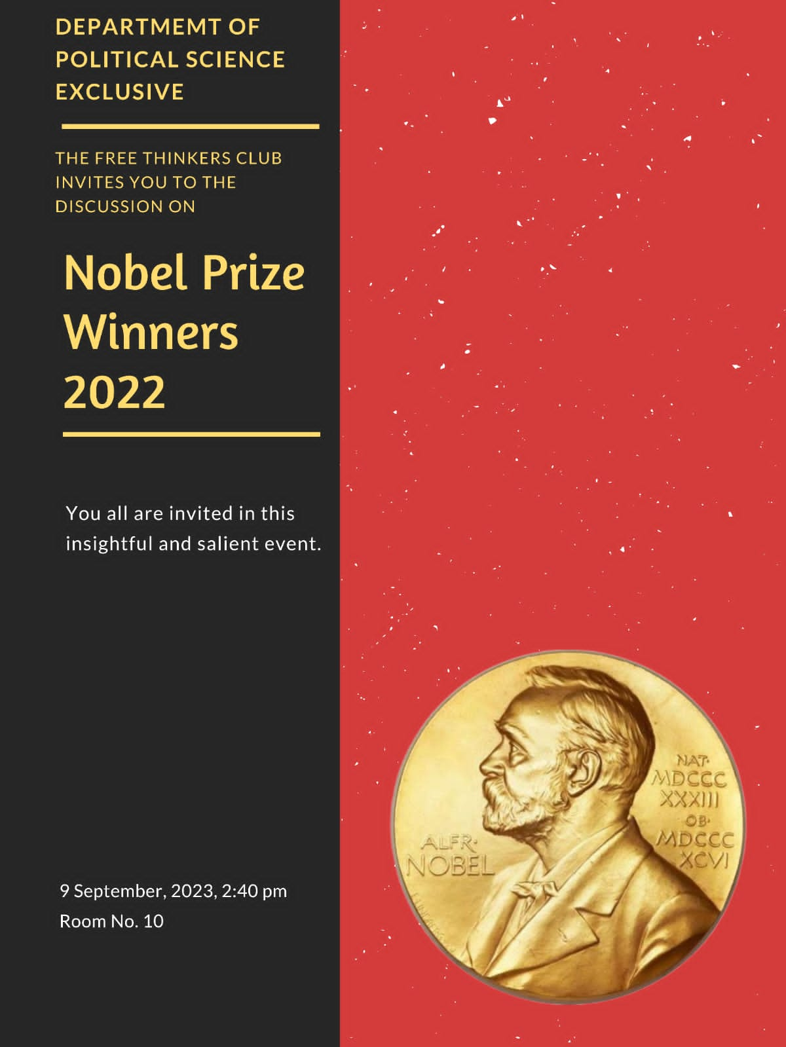
THE
INVITATION

Slide 4
AN OVERVIEW -
The Free Thinkers Club Of The Department Of Political Science organised an informative session on Nobel Prize Winners.
Five students of this club (Kavya, Aaraish ,Sneha Maanvi, Akanksha) participated in this event to make it successful under the guidence of Mr. Abhishek Thakur (Asstt. Proff. Political Science ) .

Slide 5
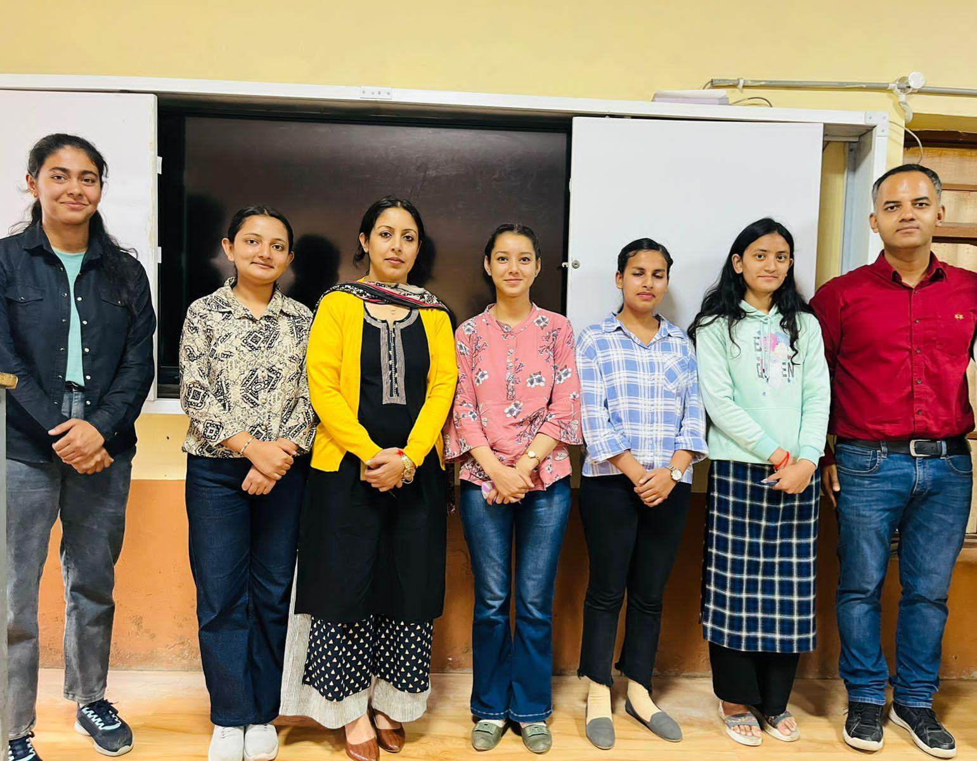
Team Members with Chief Advisor and Head of the Department.

Slide 6
PURPOSE
Major purpose of this session was to make everyone aware about the importance of Nobel Prizes .
To give them motivation and inspiration through the Novelists for their upcoming future .

Slide 7
DISCUSSED POINTS
History : In the very beginning of the session the history behind sponsoring these prizes was introduced in which it was told that how a Scientist Alfred Nobel started and sponsered this Prize .
Indian Novelists : In this part students were made aware about all Indian Novelists till 2022 in each fields.
Novelists of 2022 : In this part the students were made aware about the current winners of 2022 from all over the world and from all over the fields .

Slide 8
INTERACTIVE Q and A SESSION
At the end of the event a very special Q and A Session took place in which our professors including Mr.Abhishek Thakur , Mr. Shubham Chaudhary and Mr. Sandesh Kalta answered our questions that how India can do better in the field of research and development and how youth can co-operate to make India a better nation .

Slide 9
Conclusion
The event of Nobel Prize Winners was a medium to aware people that why India is lacking in the field of research and development and why our nation is lacking in getting such kind of prestigious prizes .
In this session everyone were being made aware about what , how and why India can be more successful in such kind of fields .
Students were made aware that upcoming Novelists can be anyone the person may be the one among us . But for this big achievement one must have the potential and one must prove his excellence and worthiness towards mankind .

Slide 10
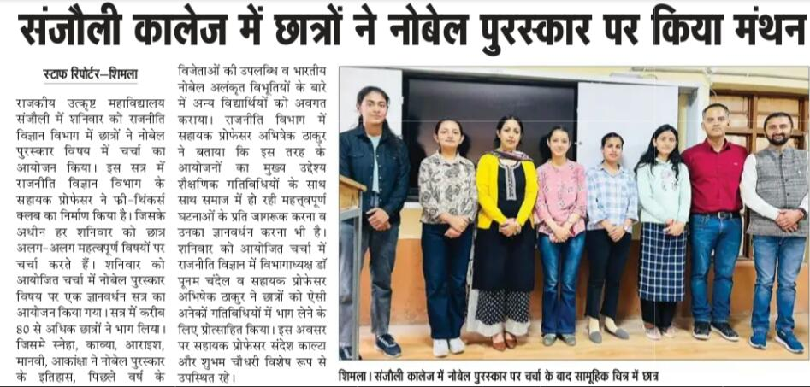
This event of Free Thinkers Club was covered by “Divya Himachal Newspaper”.

Slide 11
Prepared by : Assisted by : Kavya ( BA 2nd year). Mr.Abhishek Thakur
Roll no – 22508023. Chief Advisor Free thinkers Club
Assistant professor
Department Of Political Science

