Slide 1


Slide 2
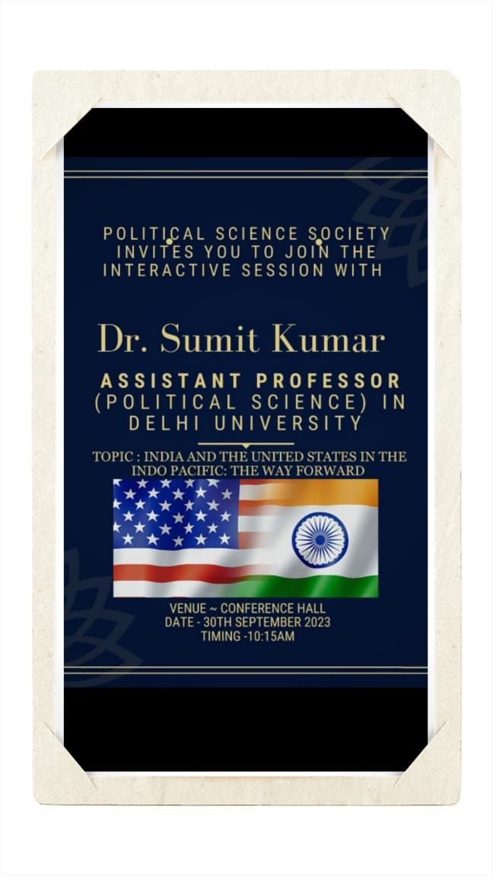

Slide 3
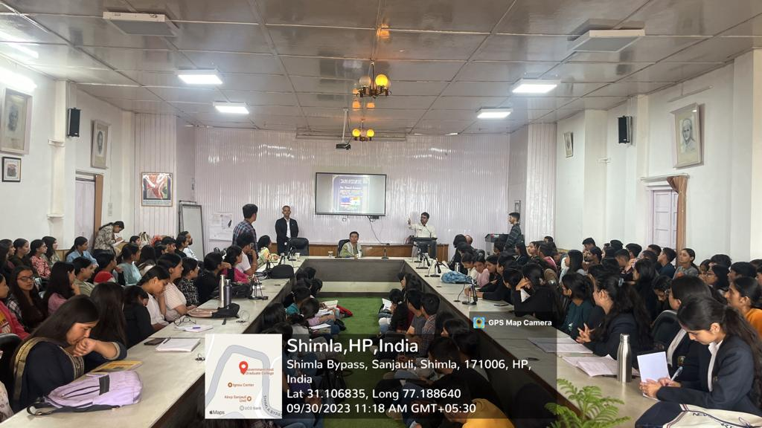
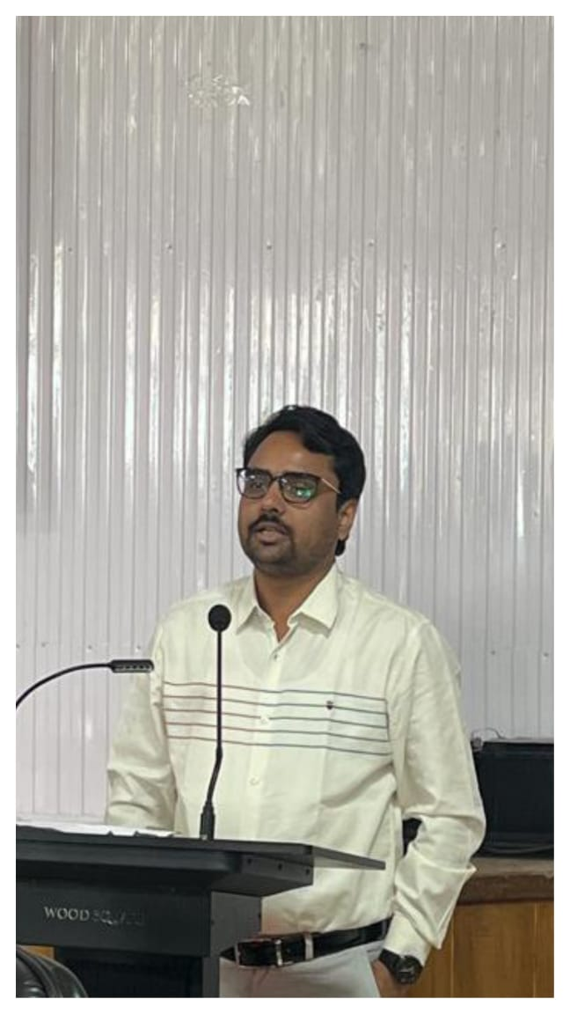
INTRODUCTION
The free thinkers club of the department of political science were ecstatic to host the live interaction engaging session on “Indo – Pacific dynamics : A Study of Indo - US bilateral relations” on 30th September , 2023 .
The Resource Person for the astonishing event was Dr. Sumit Kumar who is currently working as Assistant Professor { Political Science} in Delhi University . He had published many research papers and articles in newspaper regarding INDO – US relations .
The chief aim of the session was to facilitate discussions, exchange of ideas and a
deeper understanding of the geopolitical, economic and strategic aspects of this
important relationship of INDIA and US in the Indo Pacific region .

Slide 4
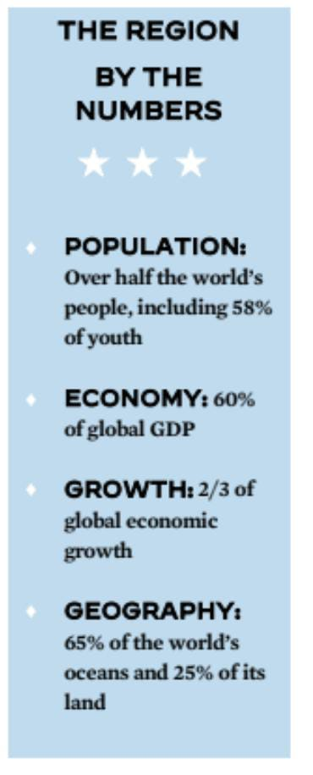
CORE HIGHLIGHTS OF THE EVENT :
Decoding INDO- PACIFIC Region -
The event started with the introduction to INDO – PACIFIC region and its significance for both the nations .
Dr. Sumit Kumar omnipresent the challenges in the INDO- PACIFIC regions due to monopoly of china in south asian sea as well as its growing influence in this region. The issue of Taiwan was also discussed and its importance for US and INDIA .
India and US are currently collaborating for a free and open Indo – Pacific in order to drive regional prosperity and to bolster Indo – Pacific security.

Slide 5
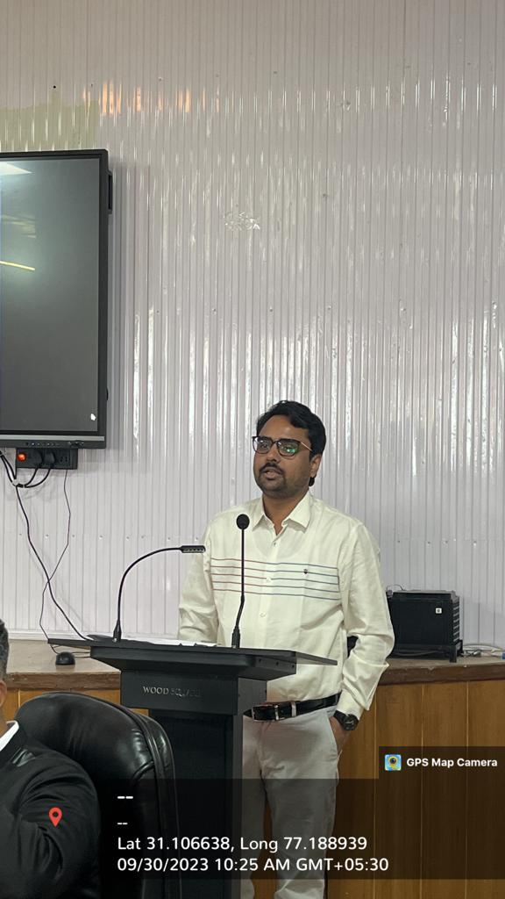
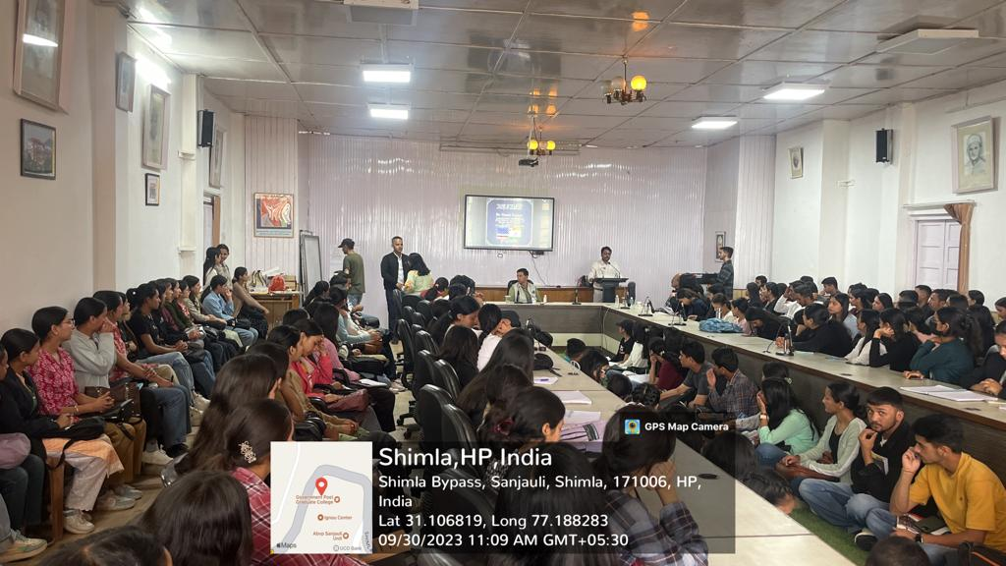
INDO – US RELATIONS
A PEEK INTO HISTORY
Dr. Sumit kumar gave an insight on the INDO – US relations history from cold war to present era . During cold war both had a distance from each other . Indian Nuclear test in 1998 led to temporary sanctions by US.
But after 2001 INDO – US ties grew stronger after 9/11 attack and many agreements were signed such as 123 agreement . As well as bilateral meetings and strategic dialogue were also started .
Barack Obama recognize India as “ MAJOR DEFENCE PARTNER”. After 2014 the relations continued to evolve and strengthen . US also called INDIA as an integral part in INDO – PACIFIC strategy in order to control the growing influence of china.

Slide 6
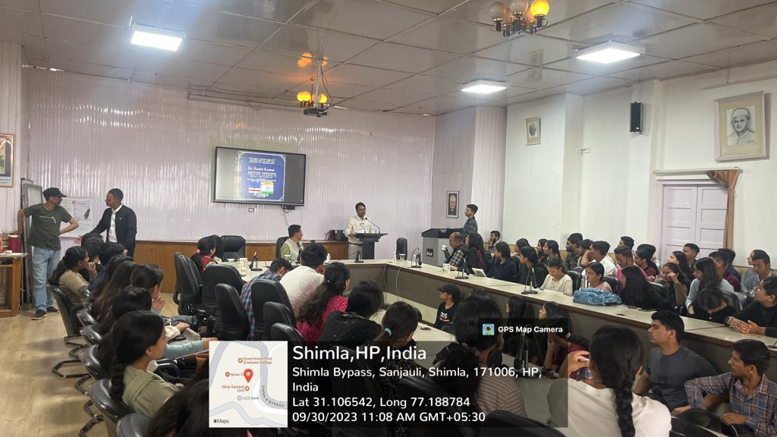
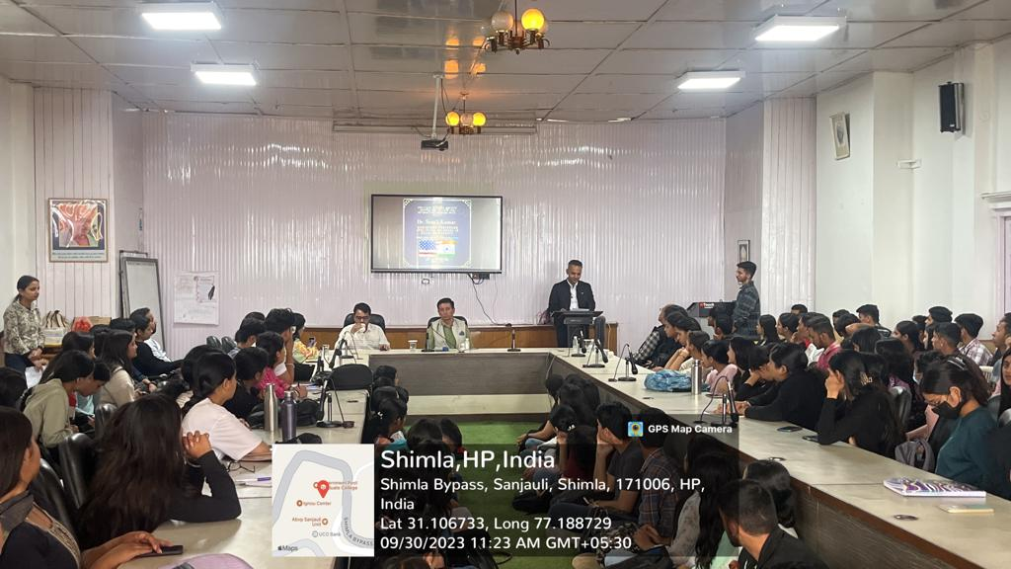
INDIA – US Bilateral Cooperation :
The Resource Person provide the students a deep analysis on the strategic partnership between the two countries as the both are part of QUAD Alliance. Also provided the detailed about the political relations and trade relations which are growing between two nations as US is India's largest trading partner with $128.55 billions bilateral trade .
Dr. Sumit kumar also laid emphasis on the defense and the cyber security cooperation like LEMOA, COMCASA, YUDH ABHYAS and BECA etc. along with space and technology cooperation as now NASA and ISRO {NISAR} are working together.
He also mentioned that many other cooperation are also taking place in Education, Health care and Clean Energy .
He also talked about the challenges in the bilateral cooperation such as H-1B visa issues, trade tensions and the India's stance on RUSSIA- UKRAINE war.

Slide 7
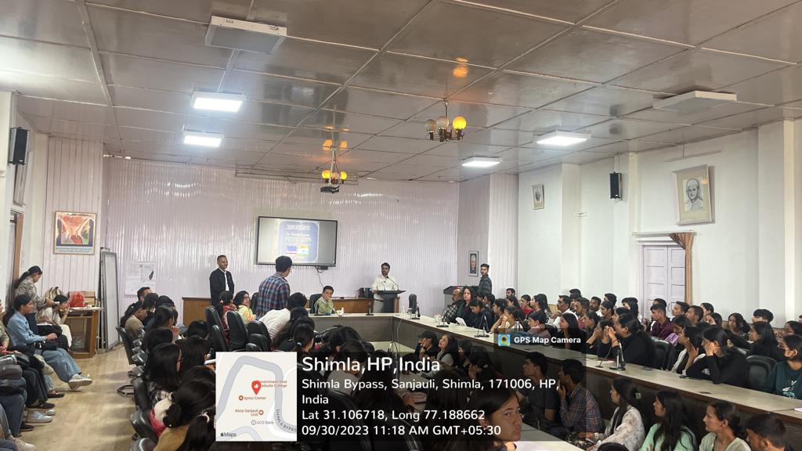
DYNAMIC EXCHANGE : “ Q & A SESSION ”
To clarify the doubts and to gain a deeper and more holistic understanding of the topic various questions were asked by the attendees including complex issues in India and China relationship, Us – India current scenario, role of Indian diaspora etc.
While answering to the question on India - US current infrastructural development projects he provide a detail of the projects like India Europe economic corridor .
On the question regarding Indo China war prediction in near future he said that both countries possess nuclear weapons , both are each other major trading partners and both are aware of the global geopolitical implications of war. And it is very hard to answer whether India will be able to win the war or not.
At last, he explained the crucial role played by Indian diaspora in strengthening the
Global Strategic partnership between the two democracies . He also added the
dominant role of the diaspora in removing the sanctions on India after the nuclear
test in 1998.

Slide 8
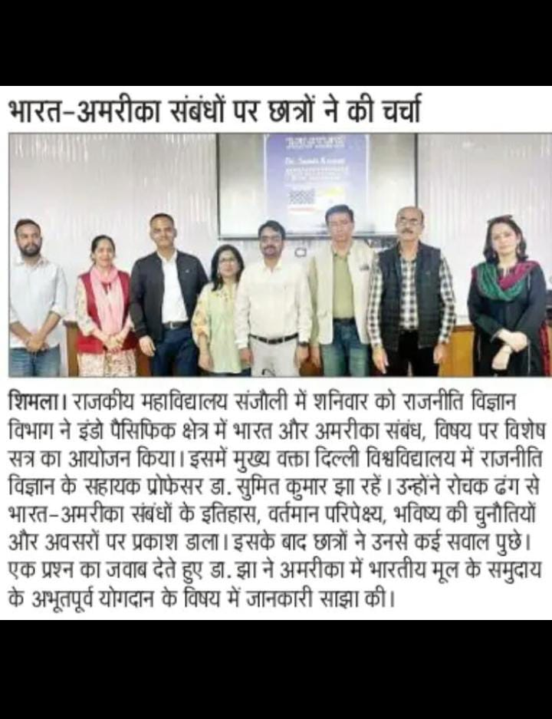
More than 200 students belonging to various streams along with many faculty members were present in the interactive workshop . The event was also covered by the local newspapers in order to spread awareness that engages the public and contributed to the intellectual growth of the people .
Such sessions provide insights into the broader geopolitical implications and helped the students to understand the complexity of the international relations . It encourage critical thinking so that students can analysis policies, challenges , potential solution after knowing the strategic and economic importance of the “ INDO – US Relations in the INDO – Pacific region”.

Slide 9
thanks
Prepared by
Miss. Swati Sharma
B.A. 2nd year
Roll No – 22508003
Core member
{Free Thinkers Club}
COE GC SANJAULI
Guided by
Mr. Abhishek Thakur
Chief Advisor
{Free Thinkers Club}
Assistant Professor
Department of political science
COE GC SANJAULI

